Slide 1
24MAT120
S2 P and M

Slide 2
Multiple Integrals (SCALAR)
We will extend the concept of a definite integral to functions of two and three variables.
Whereas functions of one variable are usually integrated over intervals, functions of two variables are usually integrated over regions in 2-space and functions of three variables over regions in 3-space.
Calculating such integrals will require some new techniques that will be a central focus.
Once we have developed the basic methods for integrating functions of two and three variables, we will show how such integrals can be used to calculate surface areas and volumes of solids.
We will also show how they can be used to find masses and centres of gravity of flat plates and three-dimensional solids.

Slide 3
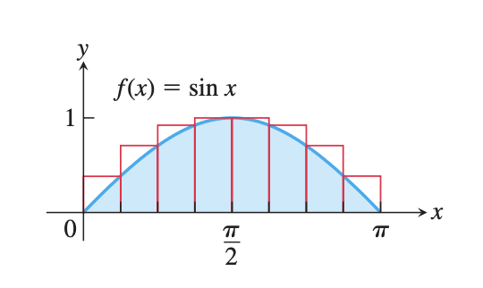
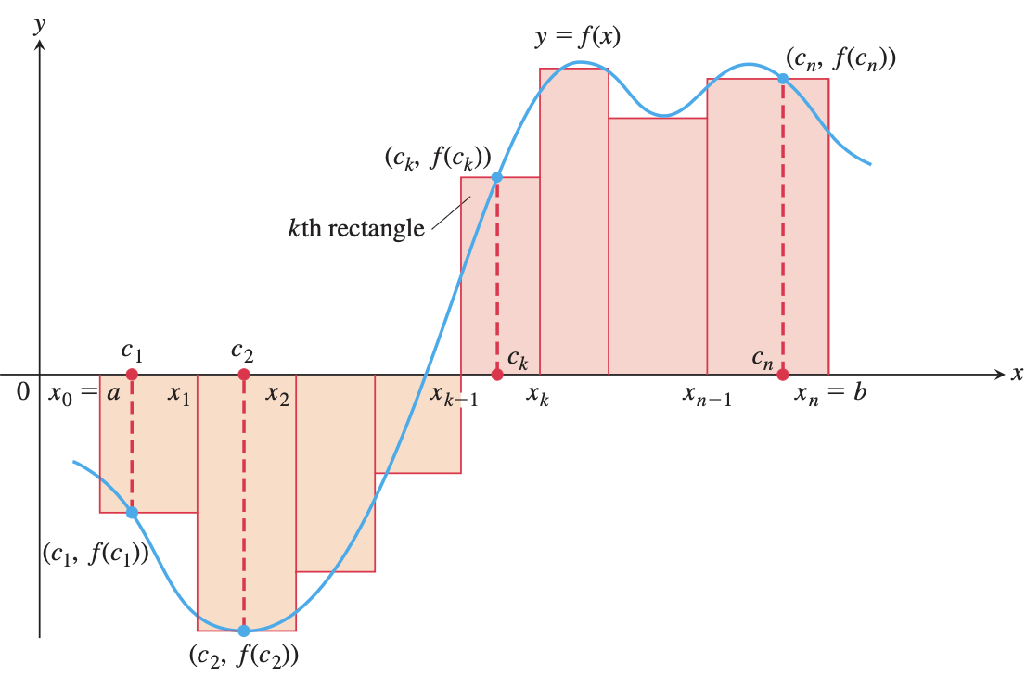
Recall SV Integration

Slide 4
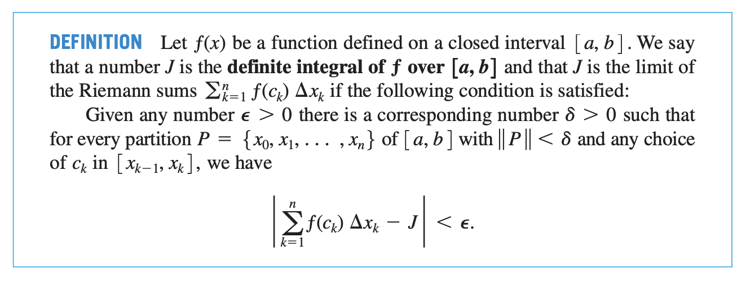
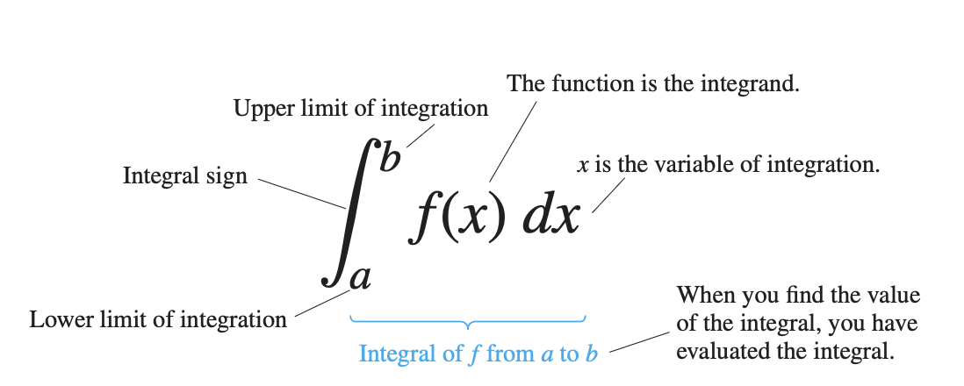

Slide 5
Field | Application
Civil engineering | volume of earthwork
Meteorology | rainfall over region
Physics | mass, center of mass
Economics | total cost over region
Medical imaging | density mapping

Slide 6
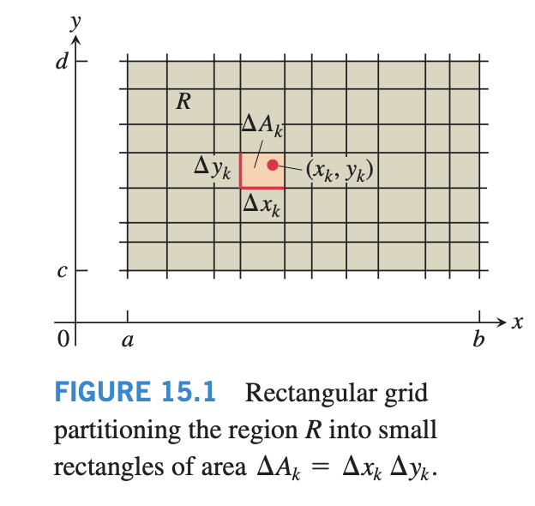
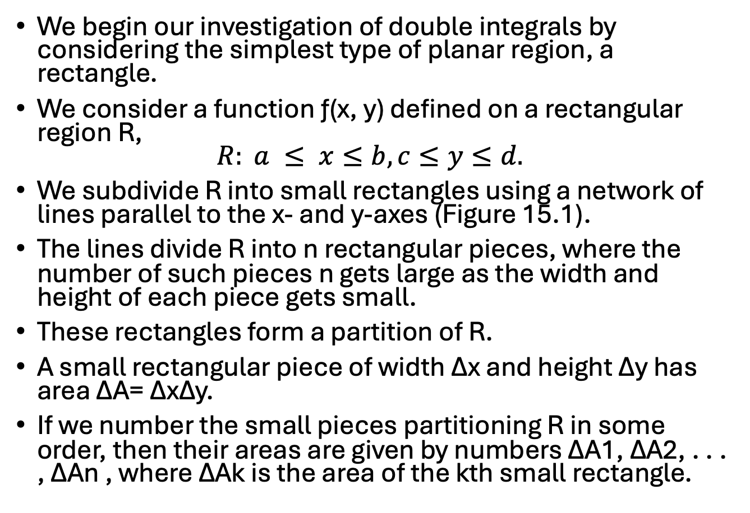
Double Integrals
We begin our investigation of double integrals by considering the simplest type of planar region, a rectangle.
We consider a function ƒ(x, y) defined on a rectangular region R,
$R: a ≤ x≤b, c≤y≤d.$
We subdivide R into small rectangles using a network of lines parallel to the x- and y-axes (Figure 15.1).
The lines divide R into n rectangular pieces, where the number of such pieces n gets large as the width and height of each piece gets small.
These rectangles form a partition of R.
A small rectangular piece of width ∆x and height ∆y has area ∆A= ∆x∆y.
If we number the small pieces partitioning R in some order, then their areas are given by numbers ∆A1, ∆A2, . . . , ∆An , where ∆Ak is the area of the kth small rectangle.

Slide 7
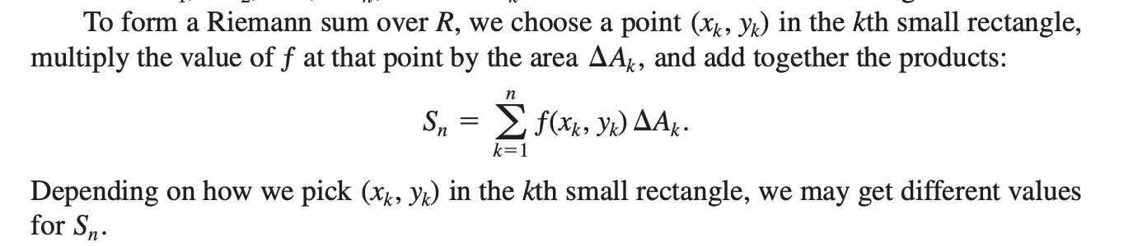

Slide 8
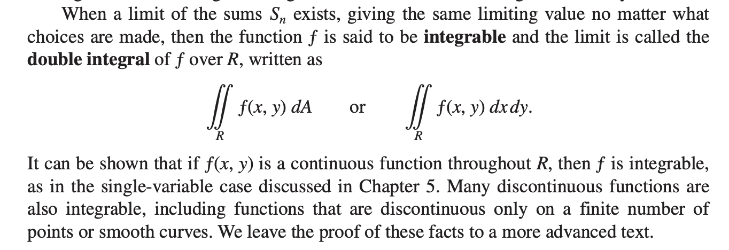

Slide 9
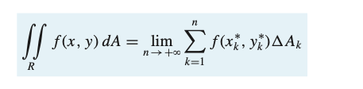
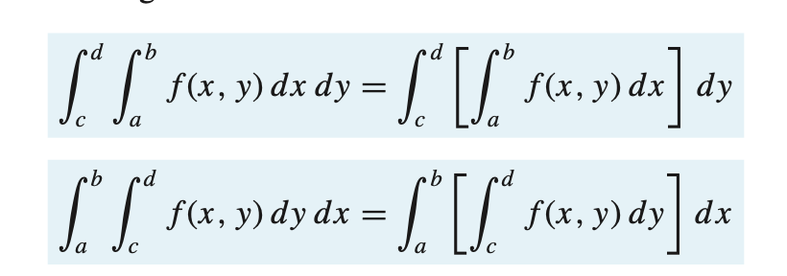

Slide 10
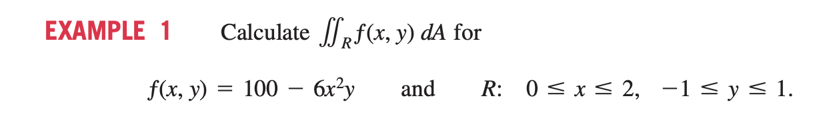
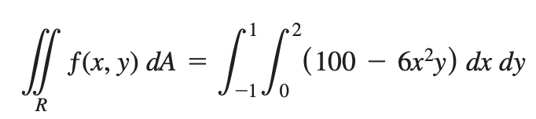
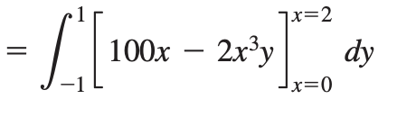
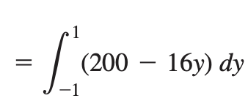
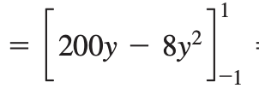


Slide 11
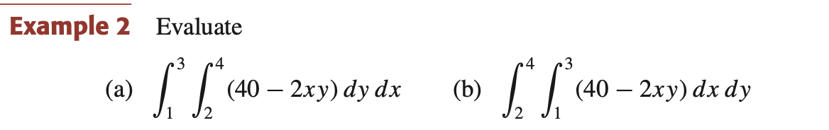

Slide 12
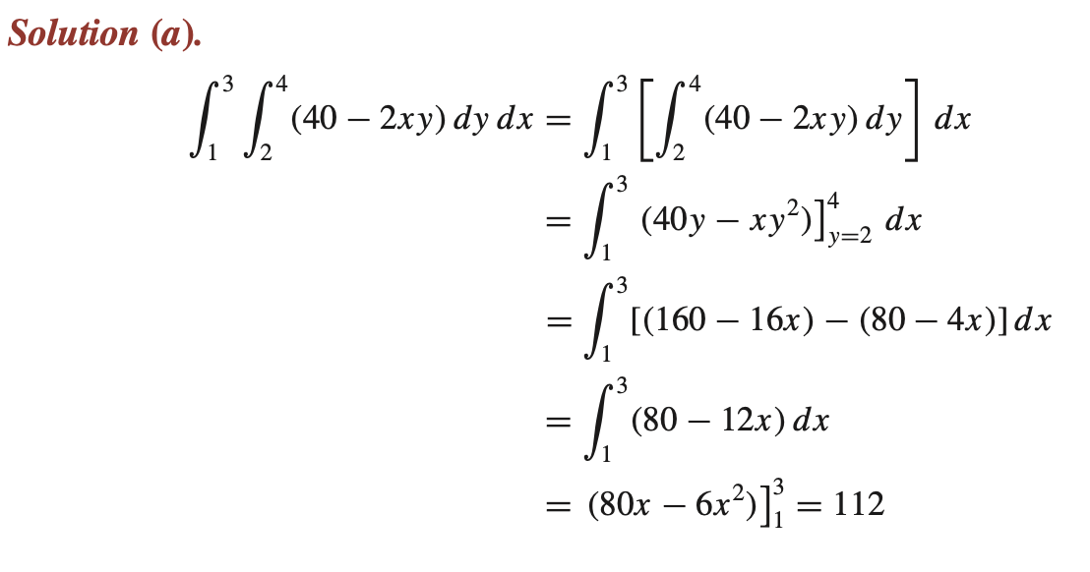
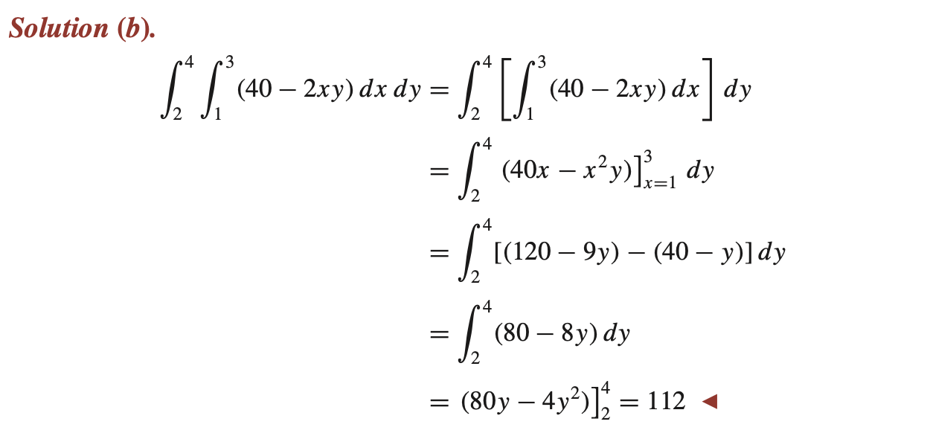

Slide 13
